Slide 1

Introducing
UrbanCode Deploy

Slide 2
Disclaimer
HCL’s statements regarding their plans, directions, and intent are subject to change or withdrawal without notice at HCL’s sole discretion. Information regarding potential future products is intended to outline our general product direction and it should not be relied on in making a purchasing decision. The information mentioned regarding potential future products is not a commitment, promise, or legal obligation to deliver any material, code or functionality. Information about potential future products may not be incorporated into any contract. The development, release, and timing of any future features or functionality described for our products remains at our sole discretion.
Information is confidential and must not be shared or redistributed without permission from HCL.
UrbanCode is a trademark of IBM Corporation, registered in many jurisdictions, and is used under license.

Slide 3
UrbanCode Deploy (UCD)
UCD on Mainframe CI/CD
UCD z/OS Capability
What is new in UCD – z/OS
Contact
4
6
7
10
12

Slide 4
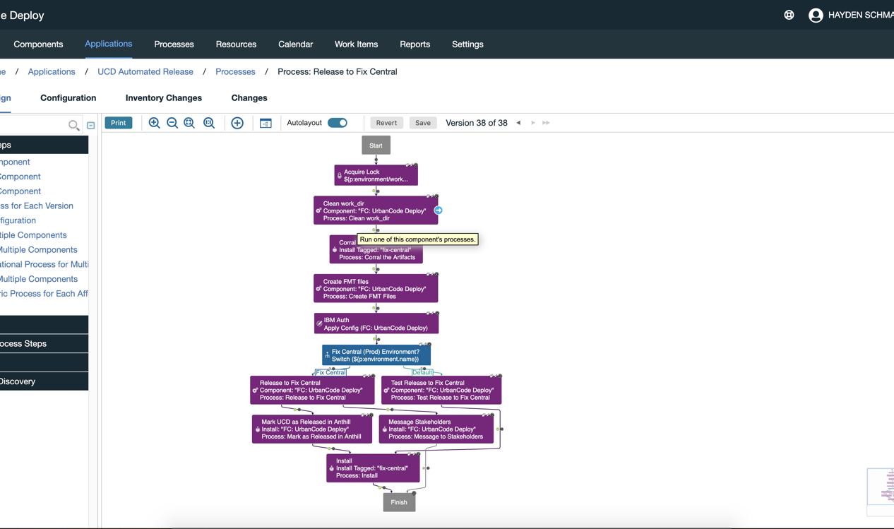
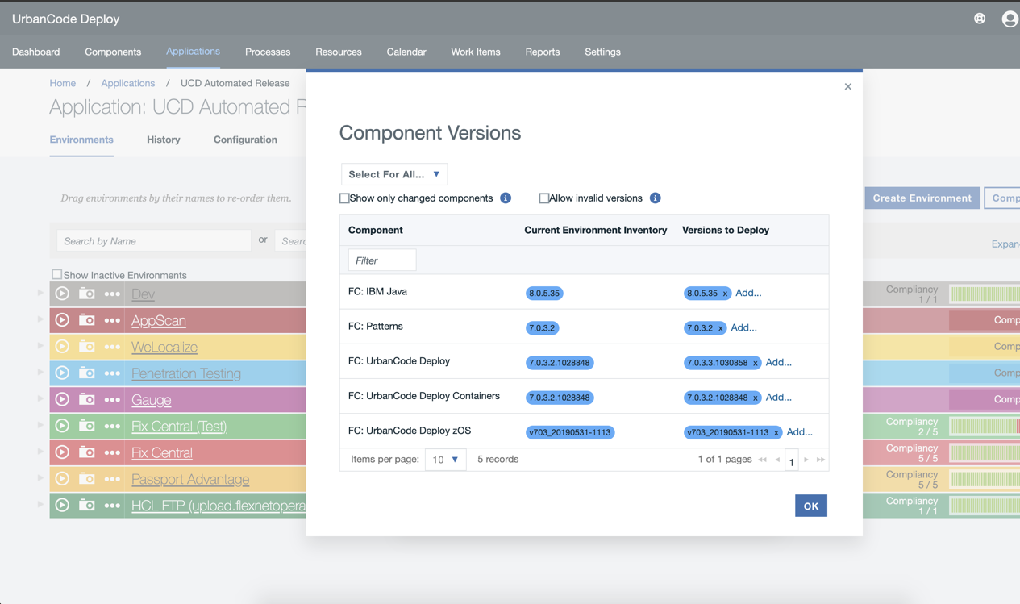
UrbanCode Deploy
Deploy anything, anywhere.
UrbanCode Deploy automates application deployments, middleware configurations and database changes to on-premise and cloud-based dev, test and production environments
Continuous Delivery Automated, consistent deployments and rollbacks of applications. Integrate with build and test tools to automatically deploy, test, and promote new builds. Go beyond automated deployment alone, and incorporate repeatability, predictability, auditability, traceability into your delivery pipeline.
Hybrid Application Support Support for all platforms: from Mainframe to distributed to microservices, both on-prem and cloud based.
Governance and Visibility Easily identify the “who, what, when, where, and how” of deployment automation. With clear visibility into apps deployed, including where and who changed them, ensuring compliance and auditing deployments and executions is a breeze.

Slide 5

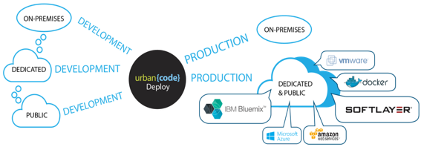

UrbanCode Deploy: Designed to support the complex enterprise
From Mainframe to distributed to cloud-native
Lift & Shift automation including moving legacy WAS applications and configuration to Cloud
06
Kubernetes container orchestration for cloud native microservices
05
Development to Test (including zDT) to Production Environments
04
03
Full governance for tracking and control
Deploy-to On-premise Mainframe, On-prem distributed, Public Cloud & Private Cloud platforms
02
PRIVATE
PRIVATE
PRIVATE
Manage all hybrid application components including traditional apps and full stack containers
PRIVATE
01
IBM Cloud Private
Kubernetes
Deploy hybrid applications with UCD
Deploy Anything From Anywhere To Anywhere

Slide 6
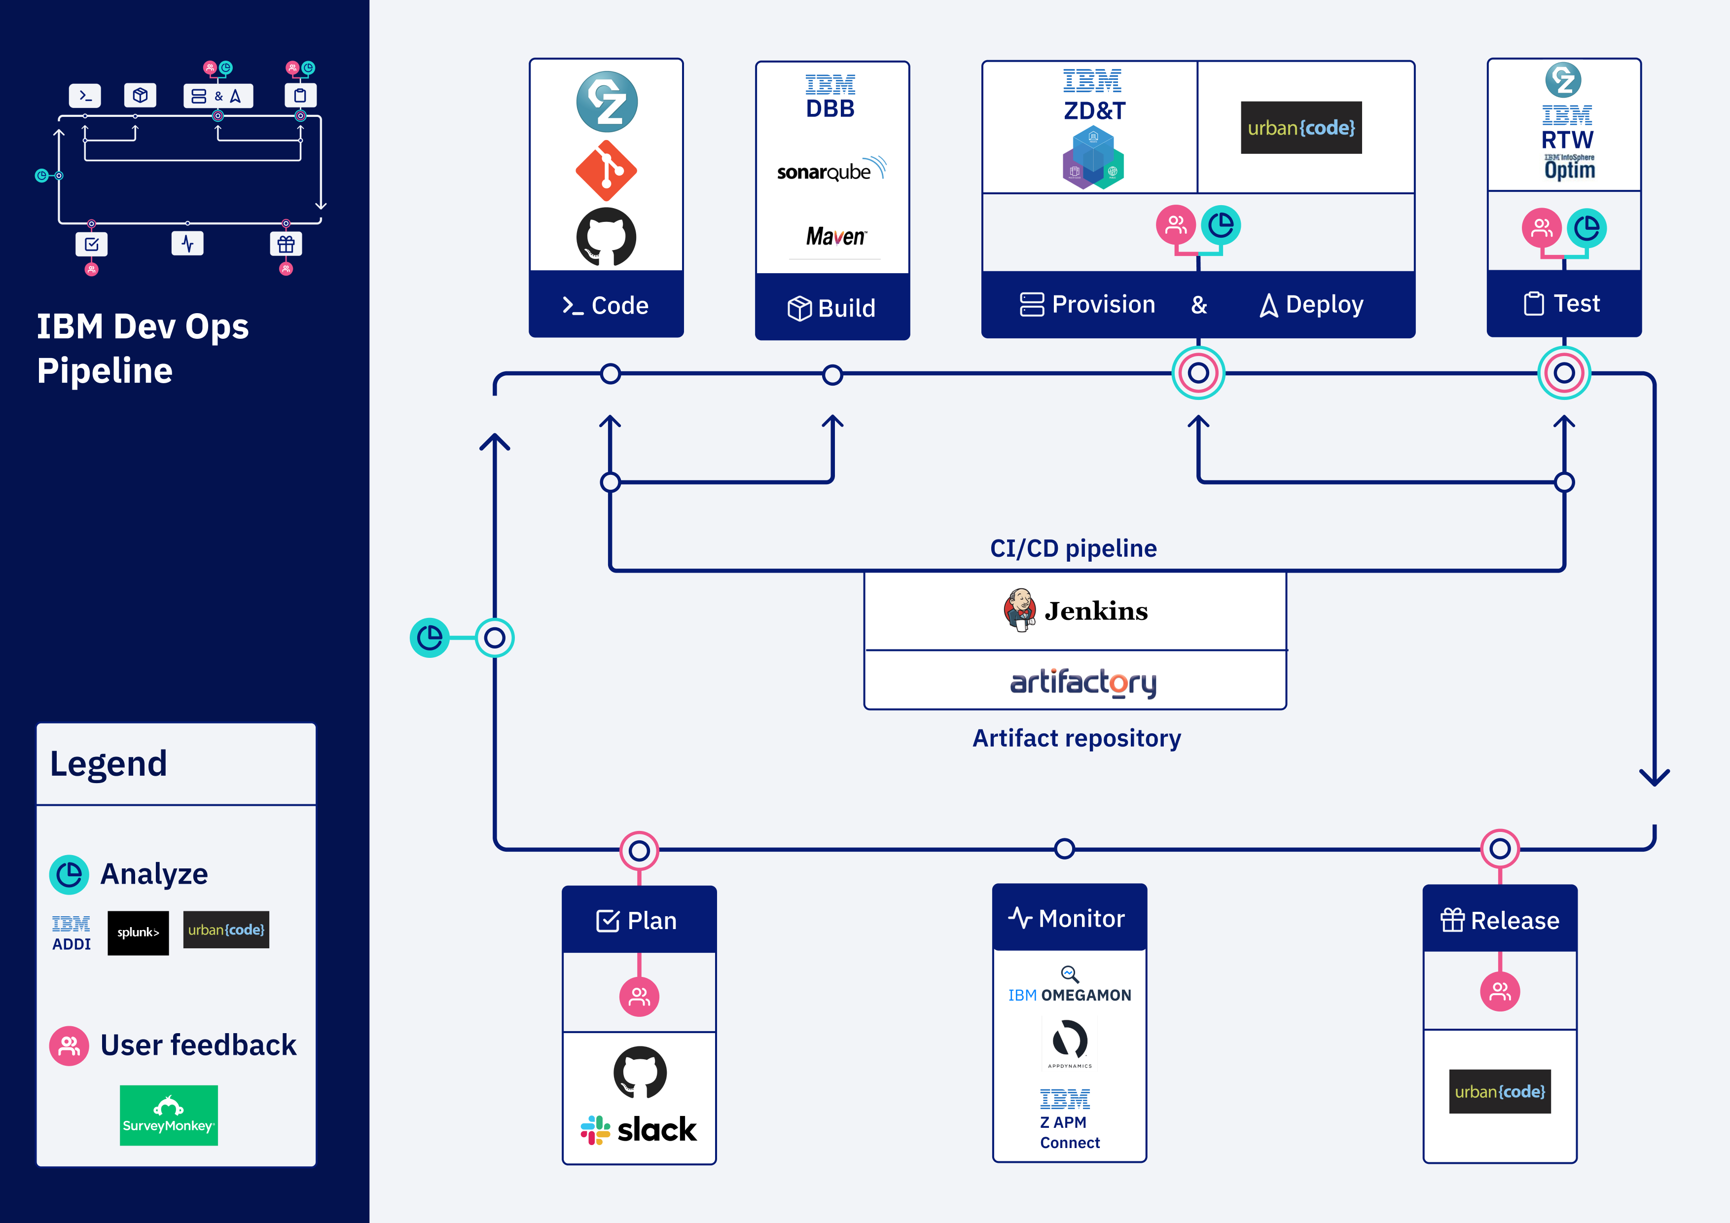
Typical Mainframe CI/CD Pipeline

Slide 7
UCD z/OS Capability
OOTB zOS Plugin
Base product
Submit job, Check job status
SCM agnostic artifact packaging
TSO/ISPF Command
MVS Commands
Incremental deploy and Rollback
REXX or Shell Script
Data set operations
z specific artifact search
Extended Plugins and Integrations
Built-in artifact repository
Security
DB2 for z/OS
WAS for z/OS
CICS
MQ
z/OS and
Linux on z
SMP/E or Zip install
IMS
z/OSMF
RTC SCM
GIT/DBB

Slide 8
Deployment overview
z/OS LPAR, Build system
z/OS LPAR
Build System
Agent
PDS
Sequential
HFS
Create Package
Download artifacts
deploy
Deploy data sets
CICS
DB2
WASz
MQz
IMS
CodeStation
In UCD
Create new version
Store version artifacts
z/OS DeployToolkit
Store meta data
More Middleware Deploy steps
Server
JCL
REXX
TSO
ISPF
MVS
SHELL
More z/OS
Deploy steps
Update Inventory status
Note: LPARs can be the same or different LPARs

Slide 9





Delta deploy and Merge
Users want to deploy only changed data set members (the delta) to the target environment.
Users can select to perform a delta deploy or a full deploy of the version.
Packaging a work item: actual artifacts from the repository are identified from build maps information of the change sets attached to the work item being packaged
Deployment / Promotion of packages PKG1 and PKG2
PgmA v1 PgmB v1 PgmC v2
PgmA v1
PgmB v1 PgmC v1
PKG 3
Delta deploy
PgmA v1 PgmB v1 PgmC v2
VersionN
PKG 2
PKG 1
PKG 2
PKG 1
PKG 3
VersionN
Full deploy
DEV ENV
TEST ENV
PROD ENV
PgmA v1 PgmB v1 PgmC v2
”Consolidated” package created taking from the artifact repository the artifacts that would result of merging PKG1 and PKG2 with the latest version
VersionN
9

Slide 10
What is new in UCDz?

Slide 11
Nexus / Artifactory Support
Buztool (Packaging script of UCD z/OS Components) from UCD 7.0.4.0 (GA-ed on October 8th) supports storing the artifacts in third party repositories like Nexus/Artifactory.
Buztool accepts a new parameter –ar that accepts a properties file with details about the third party artifact repository to store the versions. Example
buztool.sh createzosversion -c PaymentApp -s /var/ucd/shiplist.xml –ar /var/ucd/nexus.properties
Buztool stores the metadata in UCD codestation, so all the information that is visible in UCD UI today will be available if the artifacts are stored in Nexus/Artifactory.
zSearch for searching the zOS environments for an artifact will also work, as it is based on the metadata.
In the deploy component process, “download artifacts for z/OS” step will have to be replaced by “download z/OS artifacts from external repository” plugin step to download the artifacts from Nexus/Artifactory.

Slide 12
New Package Format (Beta version)
Currently the z/OS artifacts are XMIT-ed during packaging and RECEIVE-d during the deploy. Though there are a lot of advantages with the XMIT/RECEIVE, it makes the artifacts un-readable outside of z/OS. UCD handles the delta deploy / merge / replace tokens and many more functionalities differently for zOS artifacts because of XMIT/RECEIVE.
z/OS team enhanced the “cp” functionality recently to retain ALIAS-es/SSI information when we do copy from z/OS to USS or vice-versa.
In UCD 7.0.4, we have utilized the new “cp” functionality and moved away from XMIT-ing files. It is an optional feature, introduced as beta version, which will be fully functional in the next release of UCD 7.0.5. z/OS artifacts can be packaged in new format, by invoking buztool with the keyword createzosversion2 instead of createzosversion.
buztool.sh createzosversion2 -c PaymentApp -s /var/ucd/shiplist.xml –ar /var/ucd/nexus.properties
Meta data is retained in the same way as the current package format. Hence the UCD UI version page and the zSearch will work across new / old formats.
No change needed in the component process for the deployment. System would identify the package difference and would deploy accordingly.
Merge / delta deploy functionalities for the new package format will be enhanced in the upcoming versions of UCD, to make them streamlined.

Slide 13
Nexus/Artifactory Support with new package format
z/OS LPAR, Build system
Nexus /
Artifactory
z/OS LPAR
Build System
Agent
PDS
Sequential
HFS
Create Package
Download artifacts
deploy
Deploy data sets
CICS
DB2
WASz
MQz
IMS
CodeStation
In UCD
Create new version
Store version artifacts
z/OS DeployToolkit
Store meta data
More Middleware Deploy steps
Server
Package Individual Artifacts “as is”
JCL
REXX
TSO
ISPF
MVS
SHELL
More z/OS
Deploy steps
Update Inventory status
Note: LPARs can be the same or different LPARs

Slide 14
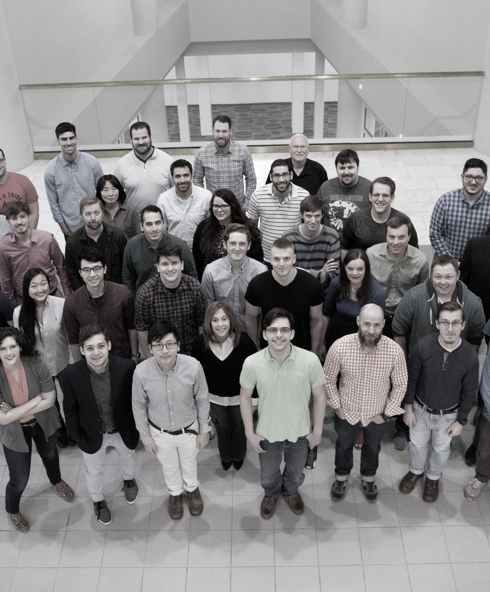

Resources:
http://www.urbancodelabs.com
https://developer.ibm.com/urbancode/products/urbancode-deploy/features/urbancode-deploy-system-z/
https://www.ibm.com/developerworks/community/blogs/invisiblethread/entry/Announcing_the_New_Mobile_to_Mainframe_DevOps_For_Dummies_Book
https://www.youtube.com/watch?v=8i7V2ZvLcUM# (DevOps for Mainframe)
IBM DevOps Value Stream Assessment:
https://developer.ibm.com/mainframe/products/devops-acceleration-program/assessment/

Slide 15
Contact Us
If you’re interested in getting started with UrbanCode Deploy, our team is ready to help. Contact us today to get started with a free trial.
Steve Boone
Head of UrbanCode Product Management
Steven.boone@hcl.com
Senthil Nathan Architect – UCDz Senthil.n@hcl.com

